Slide 1
Competitive Programming
03 May 2024

Slide 2
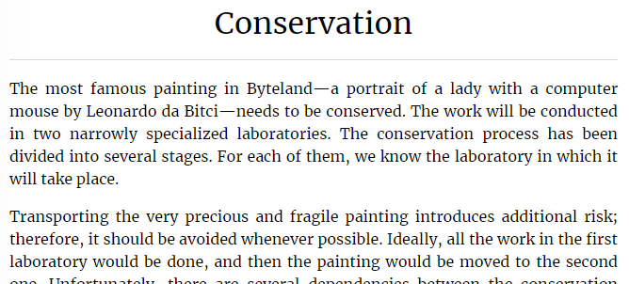
Conservation
Kattis: https://open.kattis.com/problems/conservation
Task ID: conservation
Topic: topological sort

Slide 3
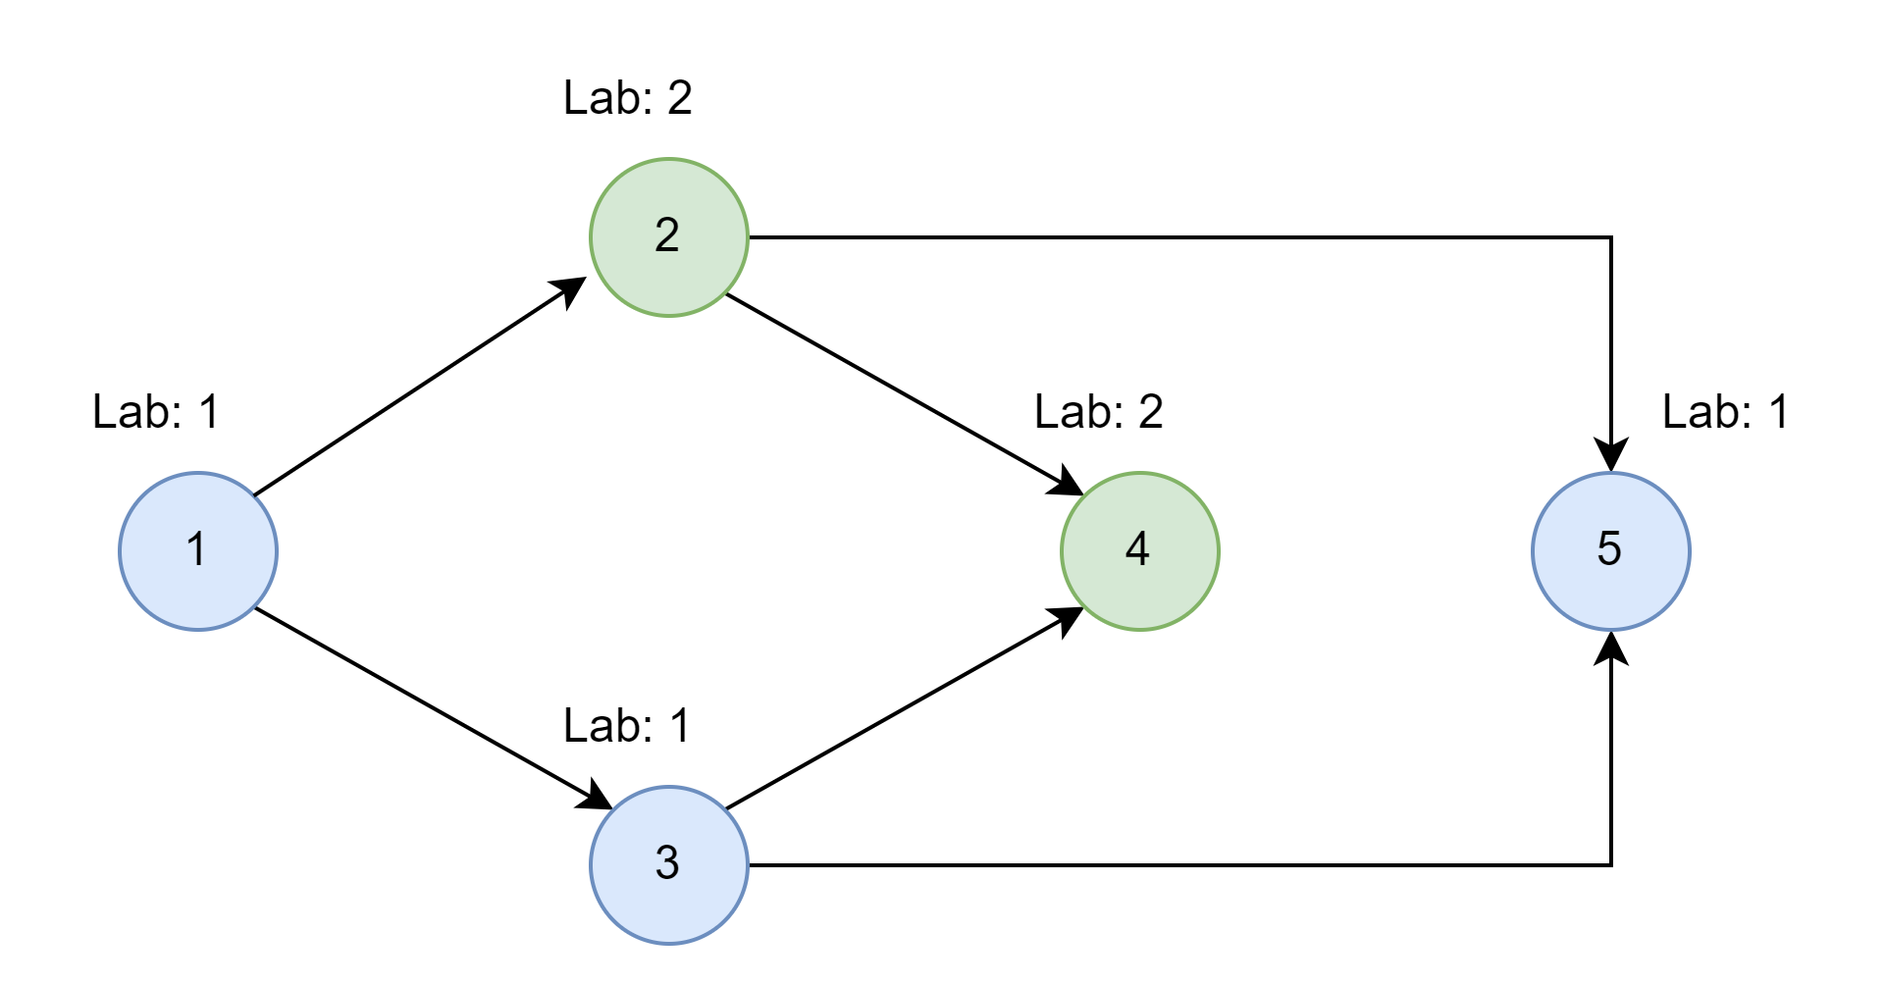
Conservation – Approach
Consider the task a graph that needs to be “topologically sorted”.

Slide 4
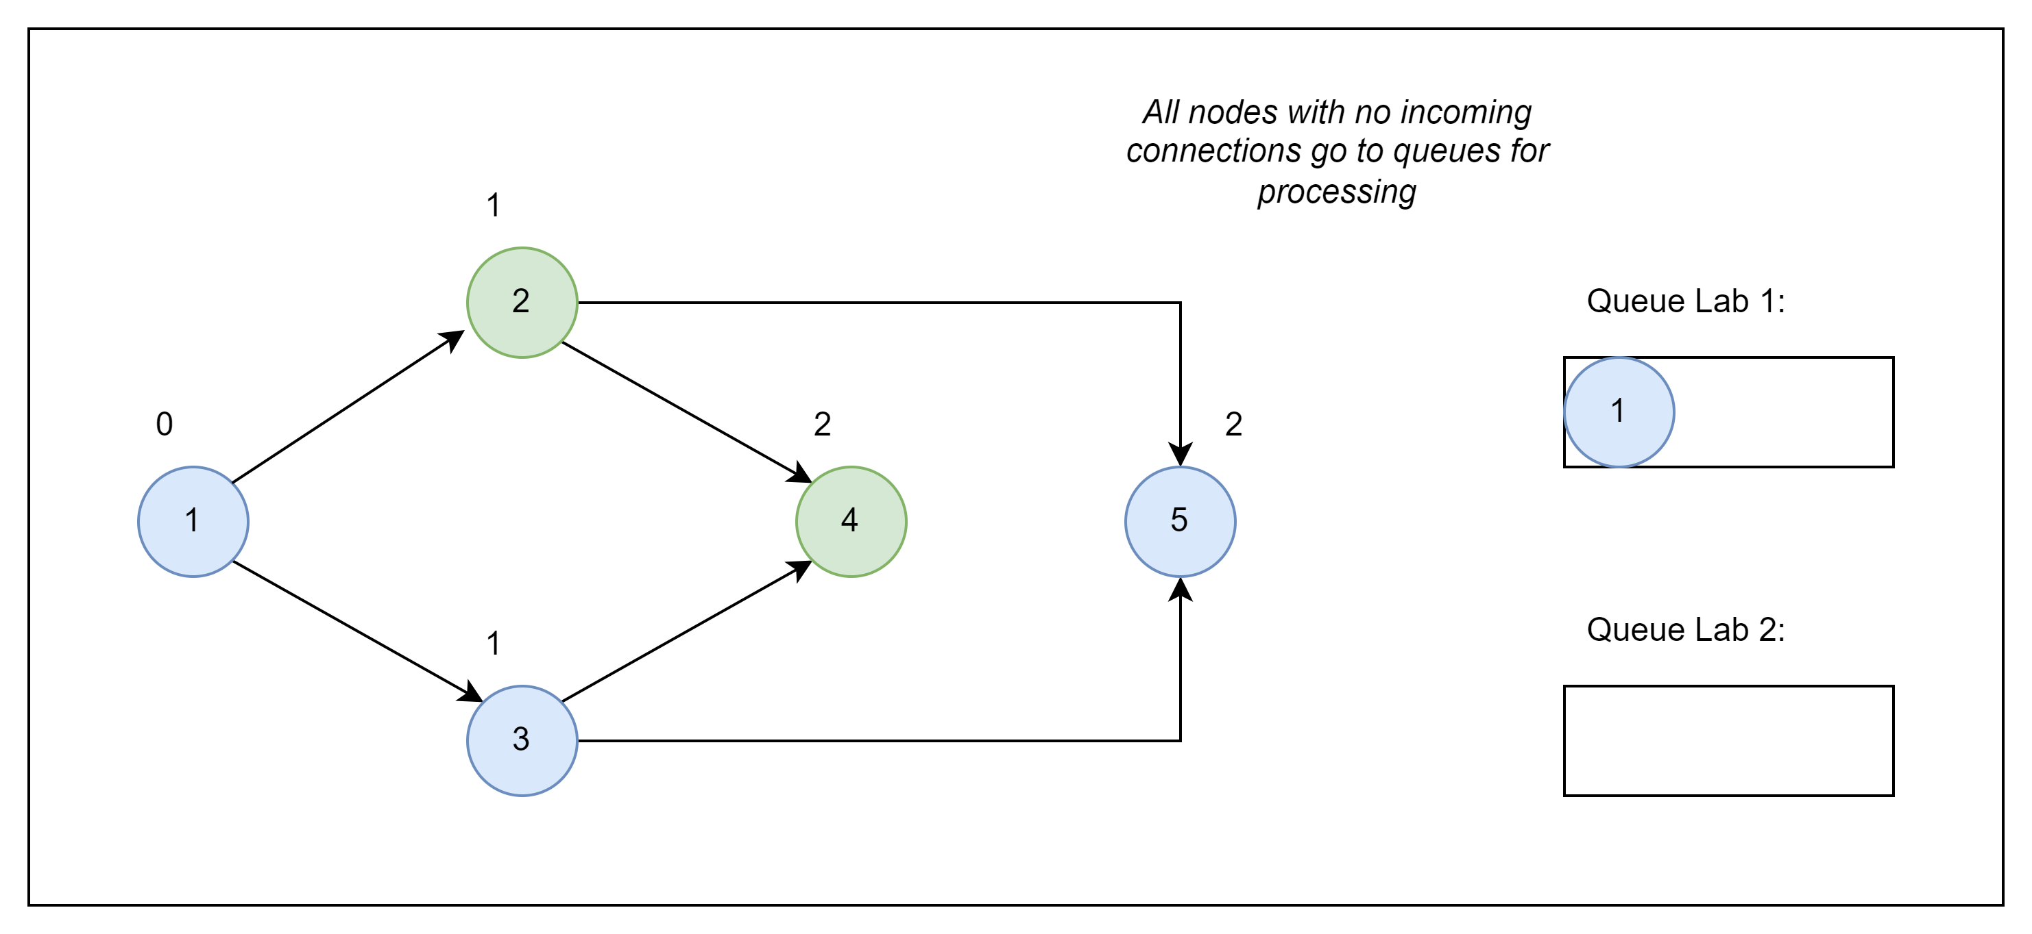
Conservation – Approach

Slide 5
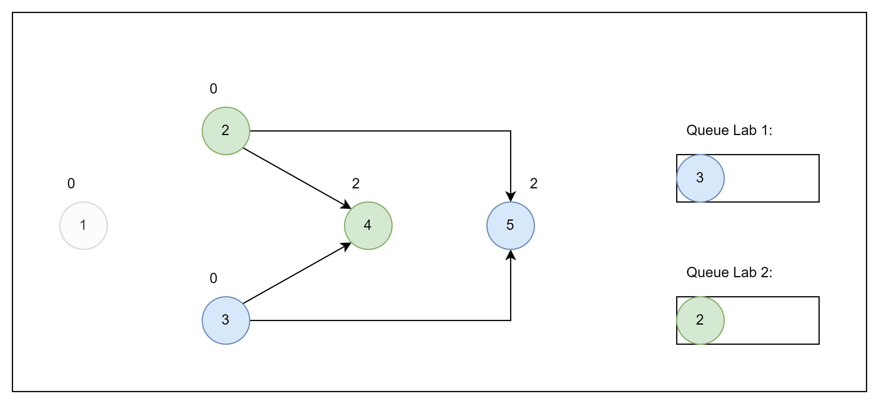
Conservation – Approach

Slide 6
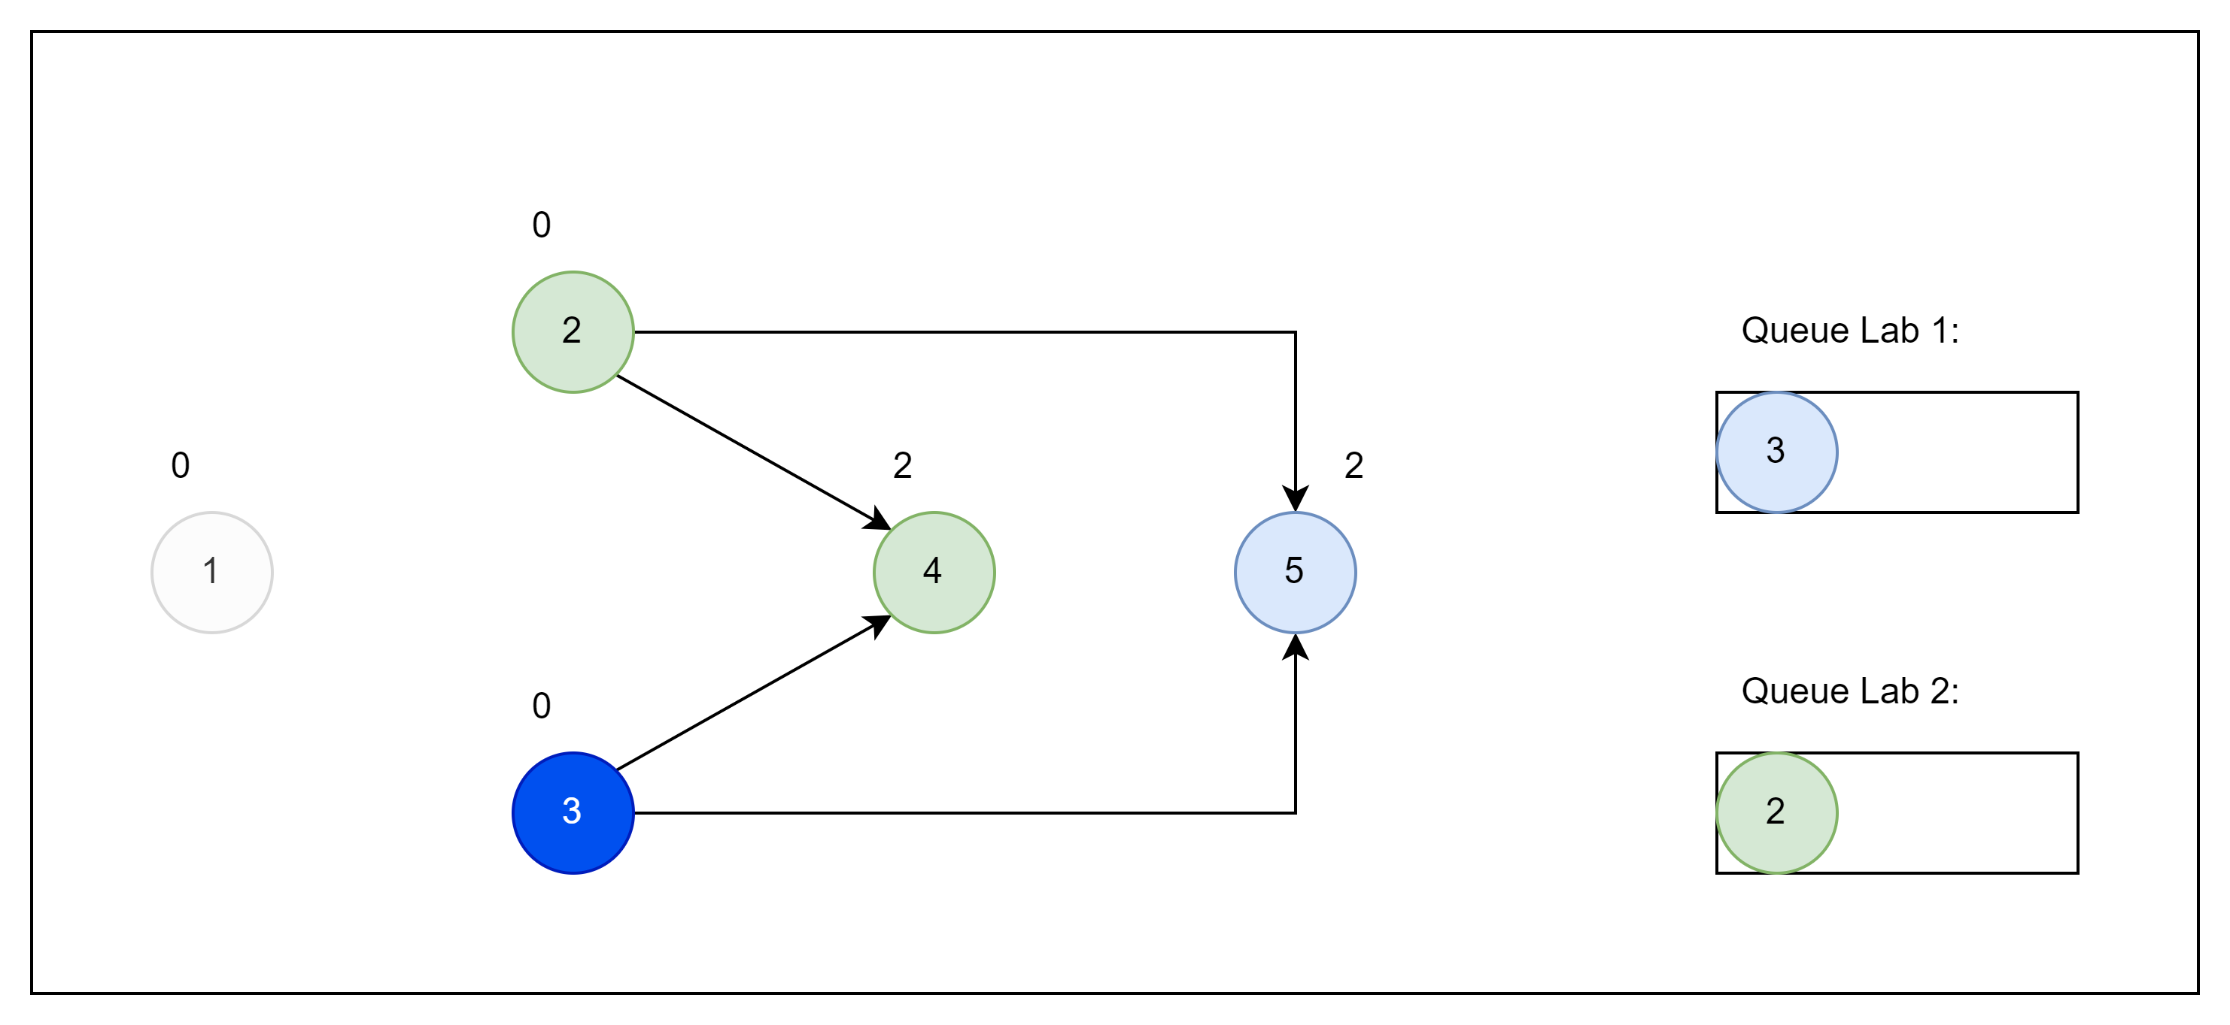
Conservation – Approach

Slide 7
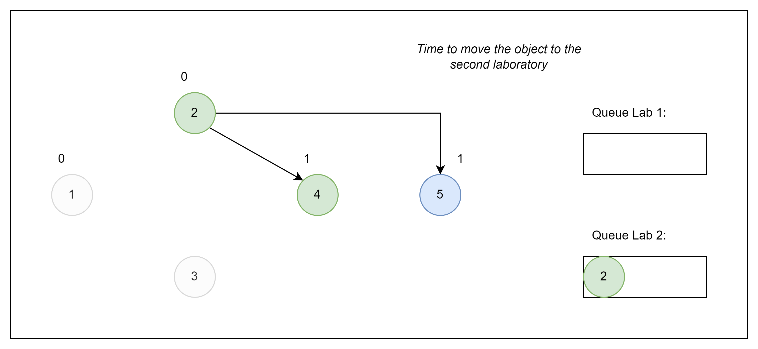
Conservation – Approach

Slide 8
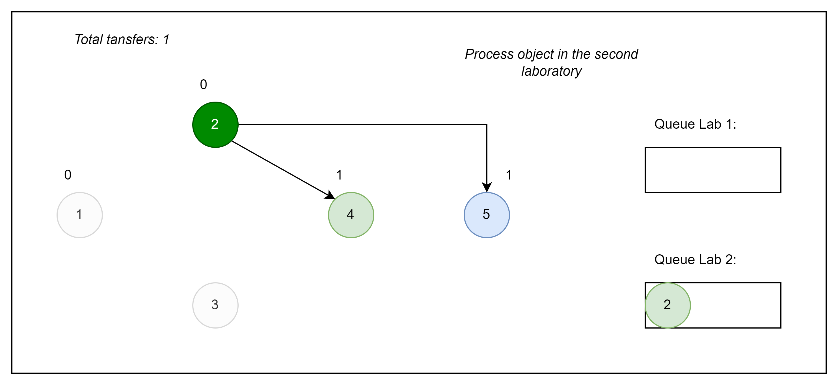
Conservation – Approach

Slide 9
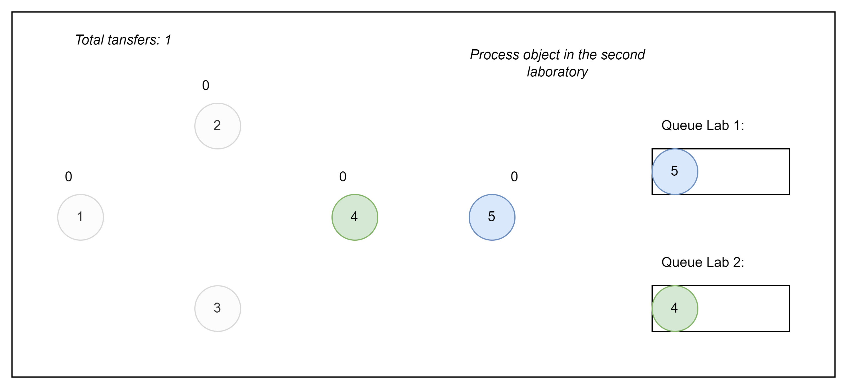
Conservation – Approach

Slide 10
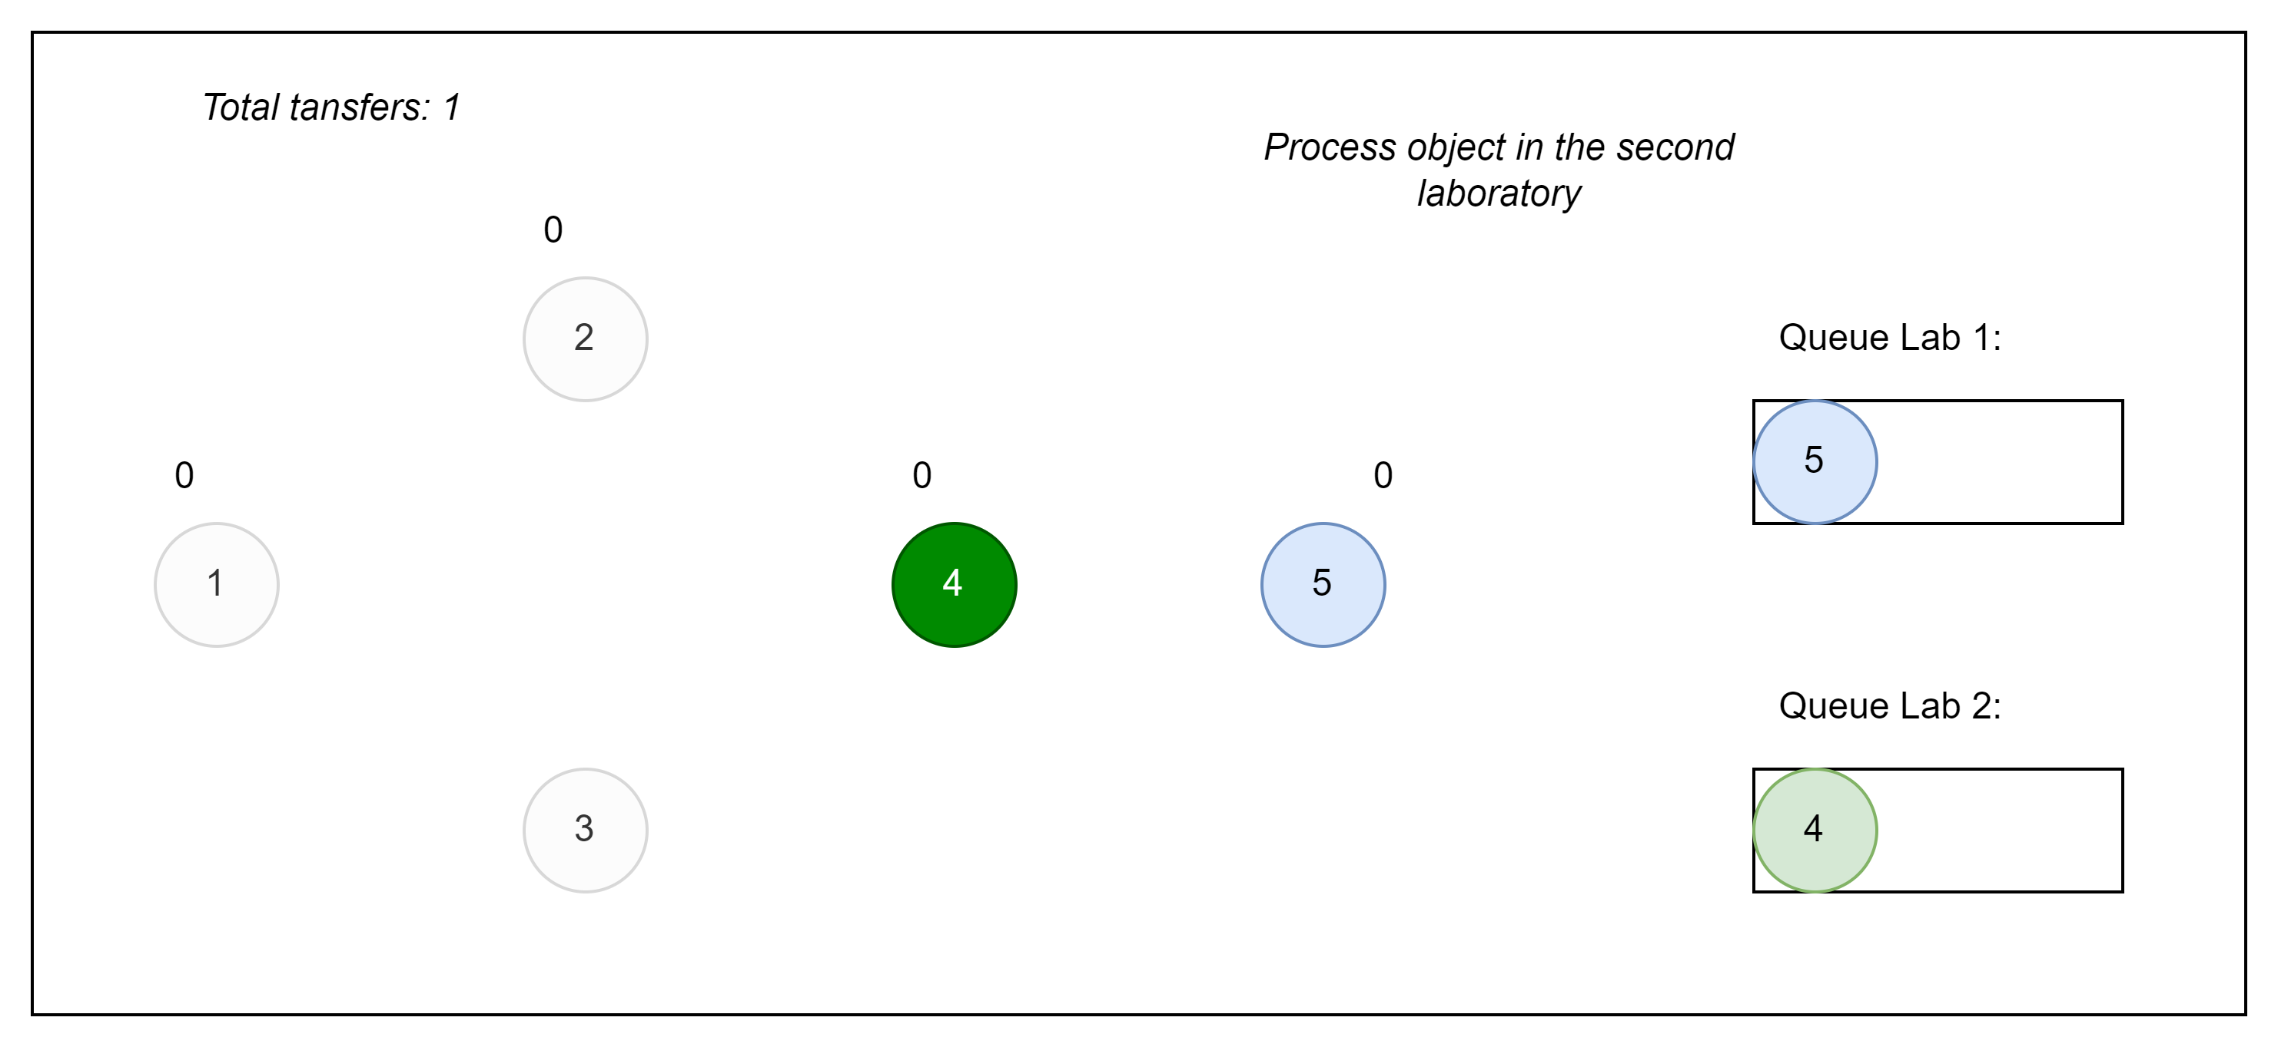
Conservation – Approach

Slide 11
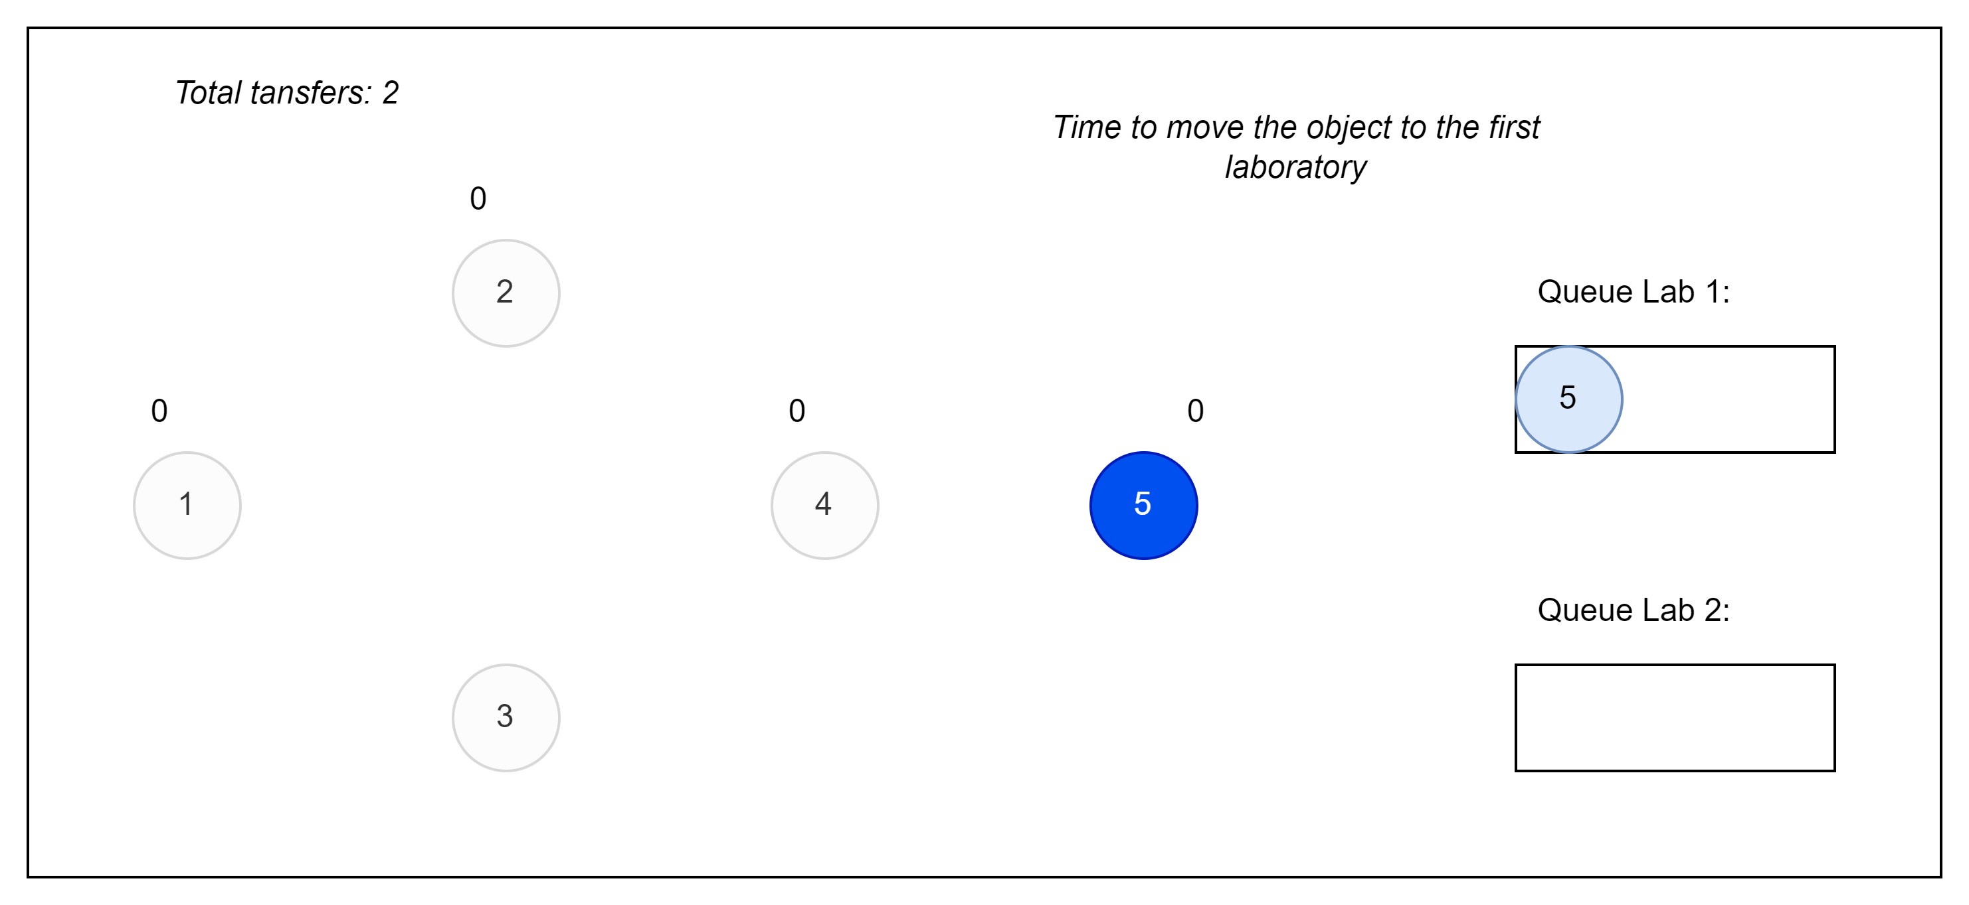
Conservation – Approach

Slide 12
Conservation – Approach

Slide 13
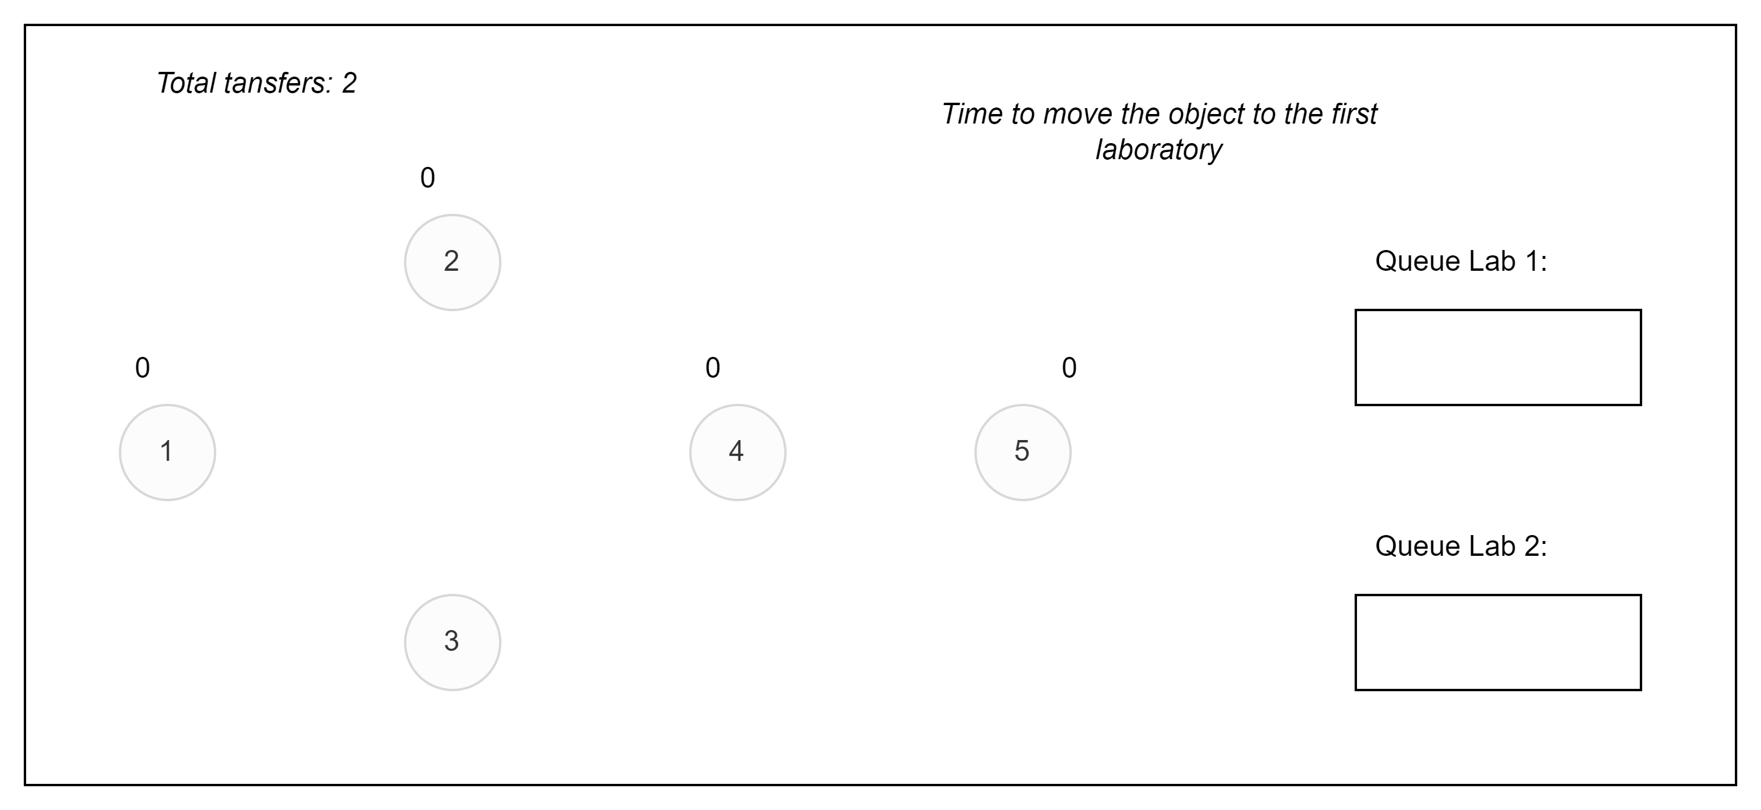
Conservation – Approach

Slide 14
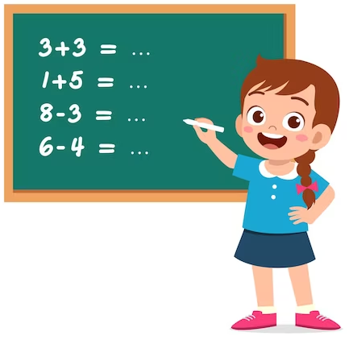
Conservation
Kattis: https://open.kattis.com/problems/conservation
Task ID: conservation
Topic: topological sort
Implement the solution.

Slide 15
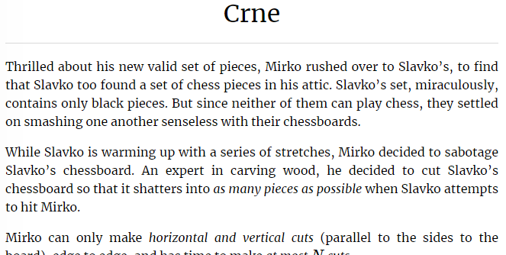
Crne
Kattis: https://open.kattis.com/problems/crne
Task ID: crne
Topic: math

Slide 16
Crne – Approach
Visualize – it helps to understand the task;
Apply math induction;

Slide 17
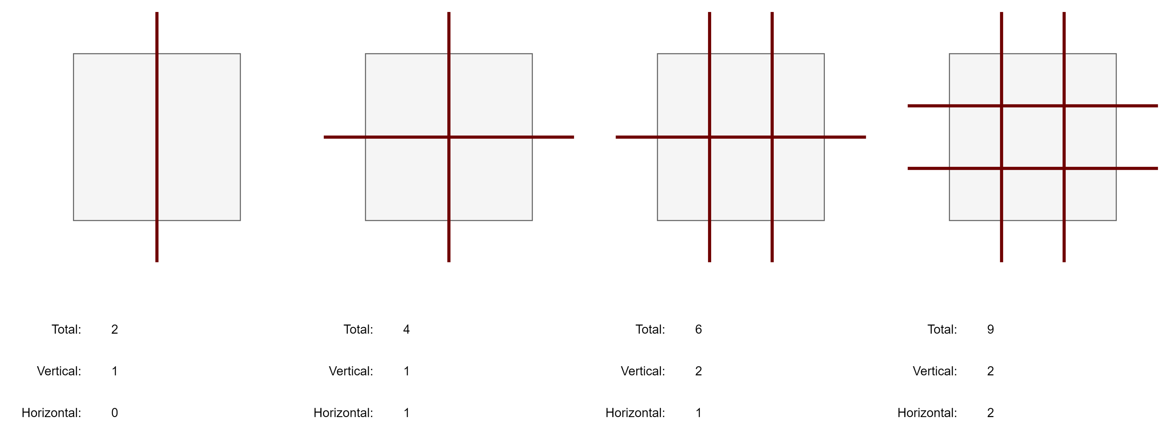
Crne – Approach

Slide 18
Crne – Approach
V = ceil(k / 2)
N = (V + 1) * (H + 1)
H = floor(k / 2)

Slide 19
Crne – Approach
V = ceil(k / 2)
N = (V + 1) * (H + 1)
H = floor(k / 2)
V = 1; H = 0
V = 1; H = 1
V = 2; H = 1
V = 2; H = 2
2
4
6
9

Slide 20
Crne
Kattis: https://open.kattis.com/problems/crne
Task ID: crne
Topic: math
Implement the solution.

